Slide 1
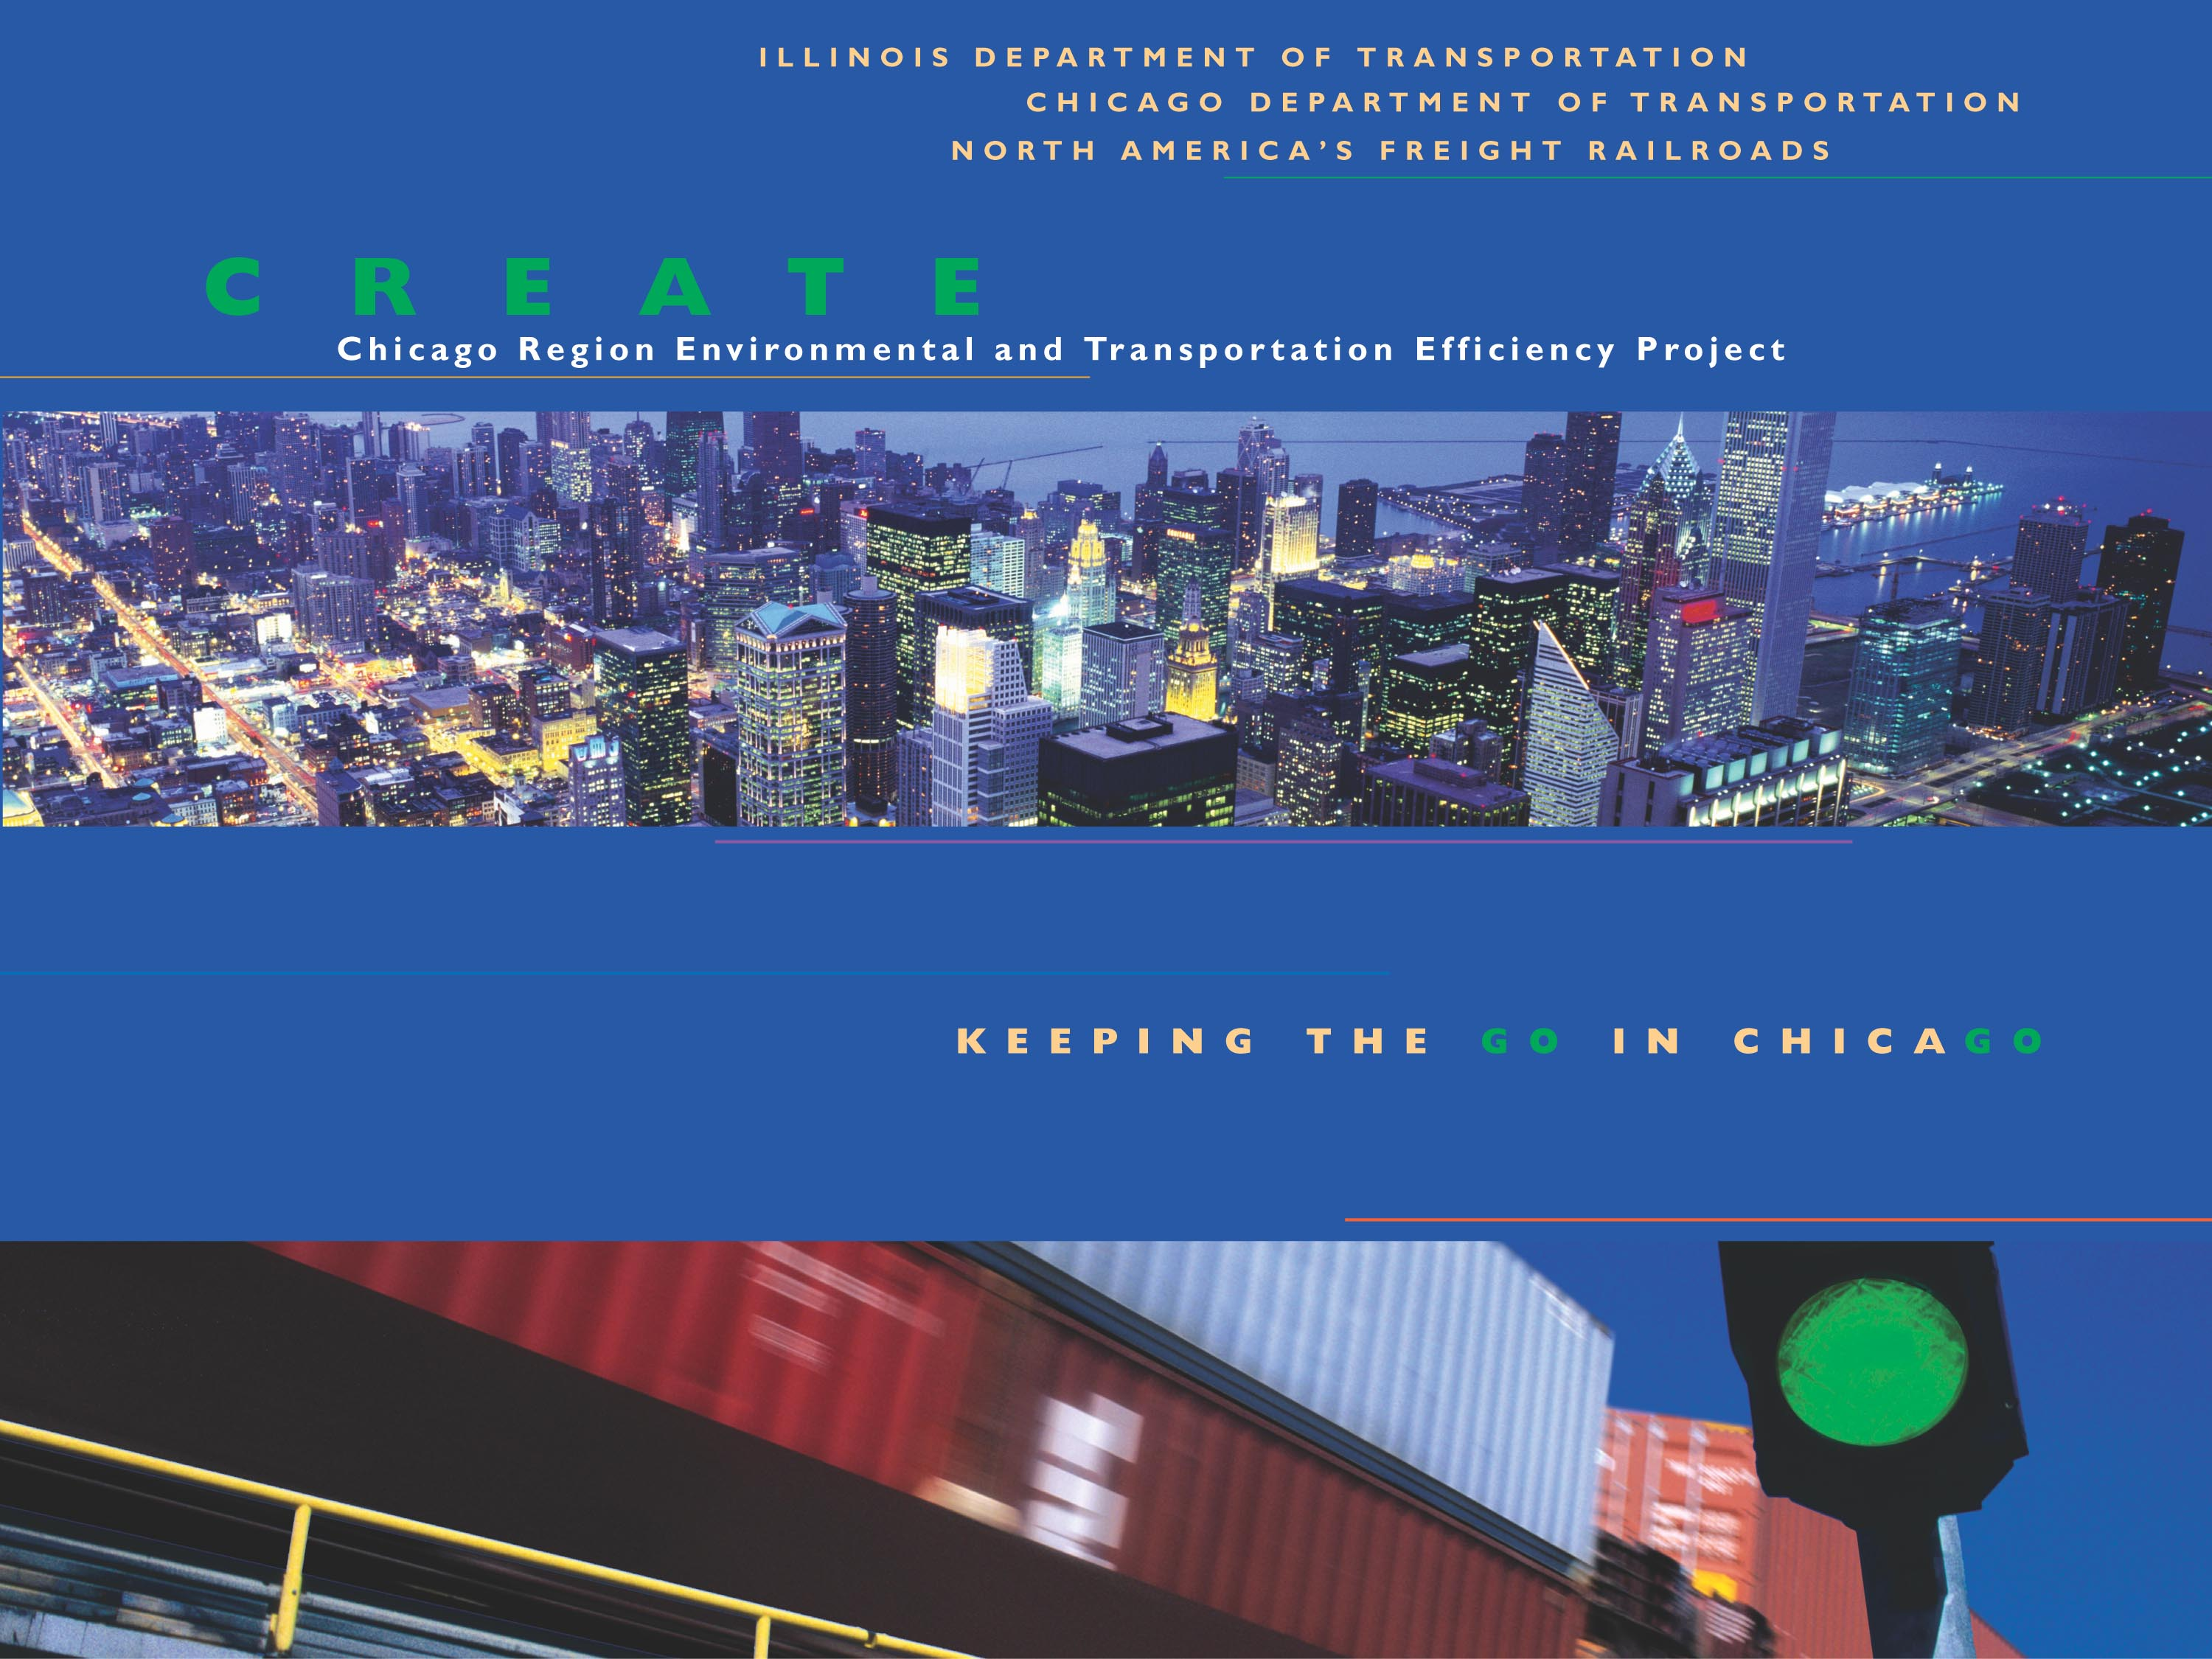

Slide 2



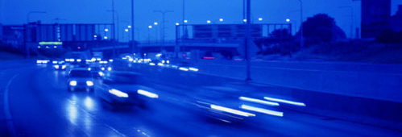

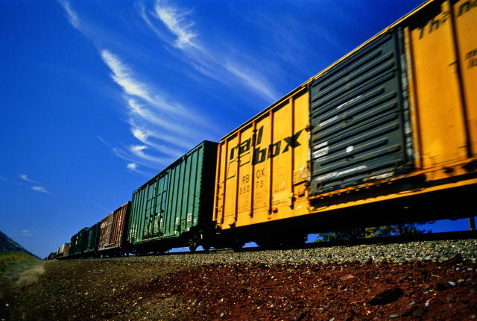


CREATE
Program Implementation

Slide 3
Presentation Outline
Organization Structure
Program-wide Standard Practices
Project-wide Standard Practices

Slide 4
Organization Structure
Stakeholder
Committee
Management
Committee
Engineering
Committee
Advocacy
Committee
Railroad Design
Group

Slide 5
Stakeholder Committee
Senior Leadership
  AAR, IDOT, CDOT
  US DOT Non-Voting Member
Approve Project Additions, Deletions, and Substantive Project Modifications
Approve Substantive Project Budget Revisions
Meet As Needed

Slide 6
Management Committee
Each Railroad, CDOT, IDOT and AAR
FHWA Non-Voting Member
Review and Recommend for Approval:
  Project Additions, Deletions, Modifications
  Budget Revisions
Bi-Monthly Meetings

Slide 7
Engineering Committee
Each Railroad, CDOT, IDOT, AAR and FHWA
Develop Program-wide Processes and Guidelines
Oversee and Approve Environmental Documents, Designs and Cost Estimates
Identify Project Deletions, Additions, and Modifications, and Budget Needs
Monthly Meetings

Slide 8
Railroad Design Group
Railroad Engineers
Develop Project Designs, Estimates and Construction Contracts
Monthly Meetings

Slide 9
Advocacy Committee
Each Railroad, CDOT, IDOT and AAR
Activities to Maintain Public Participation
Identify Community Concerns and Information Needs
Monthly Meetings or As Needed

Slide 10
Engineering Committee Process
Monthly Consultant Meetings
  Review, Provide Guidance and Approve
    Environmental Documents
    Project Designs

Slide 11
Engineering Committee Process
Monthly Engineering Committee Meetings
  Program-wide Issues
  Project Specific Issues
  Scope, Schedules and Budgets

Slide 12
Program-Wide Standard Practices
Overall Environmental Process
  SPEED Strategy
Hazardous Waste Investigation Procedures
Noise and Vibration Procedures
Air Quality – Conformity
Design Approval

Slide 13
Program-Wide Standard Practices
Process Maps
Project Implementation Processes
    Environment and Preliminary Engineering
    Final Engineering
    Land Acquisition
    Construction
State-Rail Agreements
Funding

Slide 14
SPEED Strategy
Feasibility Plan
and
Preliminary Screening
Program Level Documents

Slide 15
SPEED Strategy
EIS
ROD
N
O
Feasibility Plan
and
Preliminary Screening
Program Level Documents
ECAD
Project
Level
Docs
CE?
EA
Maybe
Y
E
S
FONSI
NO
Design
&
Constr
Design
&
Constr
Design
&
Constr

Slide 16
Project Standard Practices
Environmental Documents
  Standard Format for ECADs
  Environmental Issue Closure Status
  Street Closure Reports
Bridge Condition Reports
Log of Project Risks

Slide 17
Project Standard Practices
Action Item List
Project Schedules – Format and Software
Consultant Project Websites
Design Procedures

Slide 18
Status
Feasibility Plan and Preliminary Screening Completed August 2005
Environmental Documents Underway
  7 ECADs
  1 EA
  1 EIS
4 CEs Completed
Initiate 8 Additional ECADs in 2007
Federal funding – $100M August 2005

Slide 19
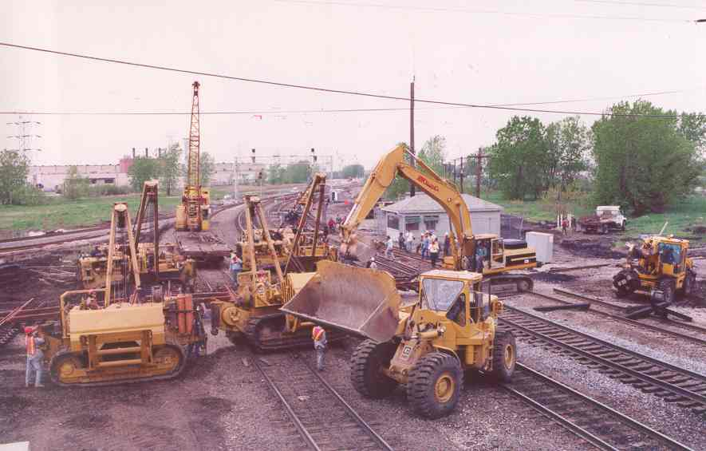
CREATE – Great Expectations

Slide 20
Contact Information
Paul Schneider
Federal Highway Administration
Engineering Project Manager
paul.schneider@fhwa.dot.gov
www.createprogram.org

